Slide 1


Columbia University
IT Strategy Plan
Group 2
Doreta Biba
Mohtasim Hossain
Katerine Lopez
Freddie Ramos
Farheen Zaman

Slide 2

Columbia Universities IT mission and objectives
CUIT Mission
Their mission is to deliver high quality,stable and secure technology solutions and services to the Columbia community, while providing IT leadership required to guide the University on its path toward the future.
CUIT Objective
Their Objective is to provide Columbia University students, faculty and staff with central computing and communications services including email, telephone service, web publishing, computer labs and electronic classrooms, course management and student information applications, office and administrative applications, and management of the high-speed campus Ethernet and wireless networks. We also manage an array of computer labs, terminal clusters, ColumbiaNet stations, multimedia classrooms, and provide a variety of technical support services.

Slide 3
CUIT Objective Distribution
Their objectives are distributed by following divisions:
Projects and Initiatives
This targets operationally sound, customer service oriented, and Columbia relevant IT projects to support the University's constant evolution
IT Policies and Strategies
They Keep Columbia secure by adhering to official policies and following strategic guidelines
IT Partners at the University
They works closely with your local IT groups across the University to provide strategic alignment on Columbia-wide technological initiatives
CUIT Communications
They inform the Columbia community of IT changes that will impact them and document important guidelines and helpful information on their site.

Slide 4
Columbia University's IT Strategies
They Developed in partnership with Columbia's localized IT groups to guide University-wide with following strategy initiatives:
API Strategy: This API strategy for Columbia explains our motivation and approach to building an API ecosystem for the benefit of our faculty, students, staff, peers and others.
Cloud Strategy: Explanation of why the use of cloud services is important to Columbia and how to benefit from them in a way that is optimal across the CU enterprise and comports to the University’s security and business requirements.
People Data Model: A comprehensive and consolidated approach to standardize data types and enable effective sharing of information about Columbia University's people: students, faculty, staff, alumni, clients, patients, etc.

Slide 5
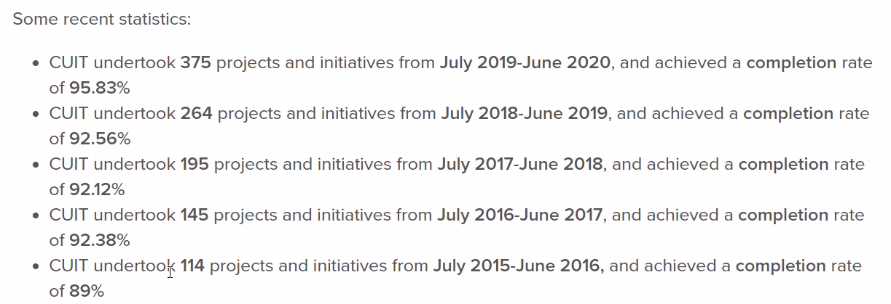
Identify key IT initiatives/projects in the strategic plan
CUIT’s mission is to deliver high-quality, stable and secure technology solutions and services to the Columbia community. To achieve this, CUIT leadership strategically selects projects and initiatives are Operationally sound, customer service oriented and Columbia-relevant in an effort to improve and modernize IT at Columbia.

Slide 6
The Office of the Chief Information Officer (CIO) provides the leadership and vision required to deliver central computing and communications services to Columbia’s students, faculty, and staff. The CIO and CUIT’s Senior Leadership Team strive to steer Columbia’s IT in a direction that is operationally sound, customer service oriented, and Columbia relevant.
Recent Projects:
From Books to Bytes: Navigating the Research Ecosystem: A set of online resources that define the research cycle, provide students with practical strategies and guide students through the resources available to them at Columbia.
Eureka!: Digital Improvisation Guidebook: Eureka is a guidebook for faculty in the use of improvisation toward those goals in the Ear Training classroom at Columbia.
Attaining Higher Education Interactive Map: CTL staff developed an interactive map tool for Beth Morgan’s Attaining Higher Education MOOC, which assists veterans in transitioning to higher education.

Slide 7
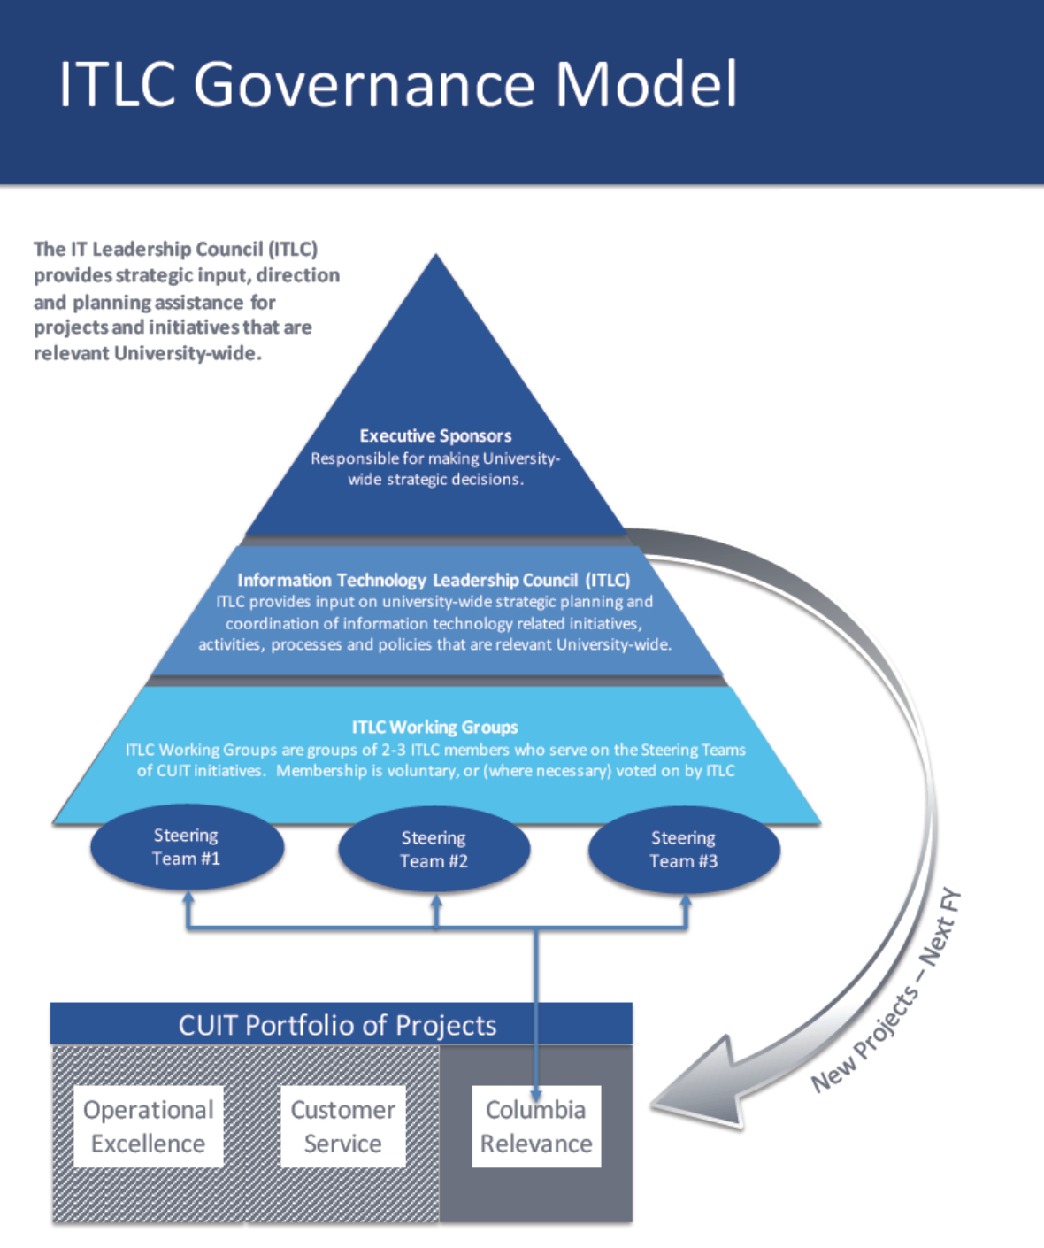

Slide 8

Identify if there is an IT Steering committee or advisory group and document their role and responsibilities
The IT steering committee acts on behalf of the Faculty and provides direction for the advancement of the overall goals of the University.
Information Technology Leadership Council (ITLC)
To enable alignment of IT Across the university, ITLC meetings and held with IT leaders representing 33 college , school, institutes and department at Columbia.
Bi-monthly meetings are held to discuss strategy and direction for university-wide projects and initiative. Council members joins working groups that meet to plan and discuss resources for relevant initiative.
The ITSC( information Technology Security Council) also convenes through the academic year, with similar structure but instead focusing specifically on IT Security.
The IT Leadership Council (ITLC) provides strategic input, direccion and planning assistance for projects and initiative that are relevant university-wide.

Slide 9
Auditor’s Evaluations.
An IT Auditor will have to evaluate and assess the following when reviewing the IT strategic plan:
Data Security Breach Response Checklist- Go over the list of tasks regarding the breaches.
Copyright Information for Network Users Policy- Ensuring worldwide web access with legal copyright for univerversity users.
Desktop / Laptop / Mobile Device Security Requirements When Accessing Sensitive Data- check the IT Security Requirements for Workstations/Mobile Devices with access to Personally Identifiable Information (PII) or Other Sensitive Information
External Hosting Policy- audit the requirements for appropriate externally hosted Columbia Data
Social Security Numbers (SSN) Usage Policy- Audits the usage of SSN and check the storage to verify unnecessary information then approve elimination.
Electronic Data Security Breach Reporting and Response Policy- deals with the incident response checklist.
Internet Domain Name Policy- audit the university’s DNS(Domain Name System).

Slide 10
For the purpose of this presentation we only utilized the Official website of Columbia University
Columbia University IT Policies and Strategies | Columbia University Information Technology
Citation

